Slide 1

Apache Felix
Dima Ionut Daniel

Slide 2
Contents
What is Apache Felix?
What is OSGi?
Bundle Lifecycle
Anatomy of a bundle
Felix Envirnoment
Felix Gogo
OSGi Bundle Repository
Conclusions
Bibliography

Slide 3

What is Apache Felix?
Apache Felix is an open source implementation of the OSGI Release 5 core framework specification.
Apache Felix provides a foundation for creating modular and dynamically extensible applications.

Slide 4
What is OSGi?
The OSGi(Open Service Gateway initiative) describes a modular system and a service platform for Java that implements complete and dynamic component model.
Open source OSGi implemetnations: Knopflerfish, Equinox, Felix.
The bundle is the modular entity within the OSGi framework.
A bundle is a collection of code, resources, configuration files.

Slide 5
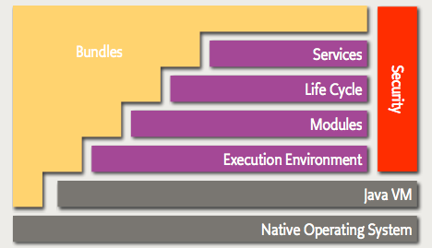
What is OSGi? (cont.)
The components of OSGi framework are:
Execution environment layer – bottom layer on which bundles live.
Module layer – bundle space
Lifecycle layer – manages and keeps track of the frameworks and bundles lifecycle state
Service layer – server-side registries and services
Security layer – extends java 2 security

Slide 6
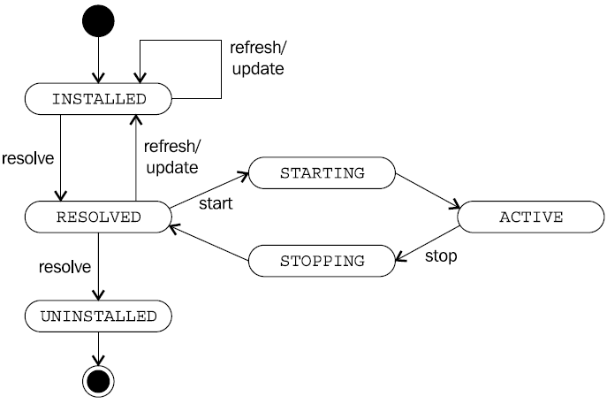
Bundle Lifecycle
The lifecycle of a bundle within a framework starts with its install.
A bundle can be installed either by another bundle using framework API or via framework implementation.
Before a bundle is active it must go through the resolution process(dependencies).

Slide 7
Bundle Lifecycle (cont.)
Bundle can be in one of the following states:
INSTALLED: the bundle has been successfully installed.
RESOLVED: all resources needed for this bundle have been loaded successfully and the bundle is ready to be started.
STARTING: the bundle is being started but hasn’t finished starting.
ACTIVE: the bundle has been successfully activated and is running, ready to be used.
STOPPING: the bundle is being stopped but has not finished stopping.
UNINSTALLED: the bundle has been uninstalled.

Slide 8
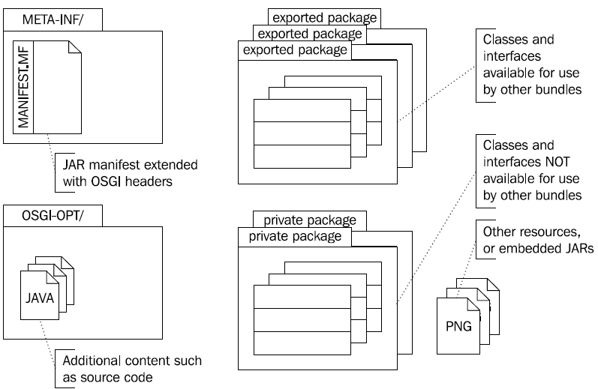
Anatomy of a bundle
A bundle holds the resources that are needed for it to provide functionality such as Java classes, resources, embedded JARs, etc.
Also it holds its OSGi headers entries in the JAR manifest file(META-INF/MANIFEST.MF).
The OSGI-INF/ directory is used to hold bundle-related configuration and properties used by the framework.

Slide 9
Felix Envirnoment
Felix distribution contains the following structure:
bin: main application jar(fellix.jar)
bundle: auto-deploy directory where bundles are automatically installed and started by the framework
conf: configuration files.
doc: useful documentation on the install and configuration of the framework
felix-cache: folder created after application is started for the first time and contains local framework cache.
Felix Gogo is the default shell environment for the Felix framework.

Slide 10
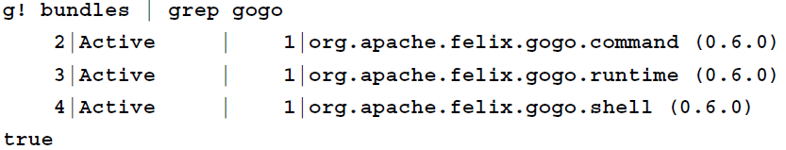
Felix Gogo
Felix Gogo is a sub-project of Apache Felix.
The Gogo shell is included with the Felix Framework Distribution since version 3.0.
The command syntax for the shell interface is based on the Tiny Shell Language(TSL).
The Gogo shell allows the execution of chained execution blocks(ex: bundles | grep gogo).
In the shell variables can be assigned with different values.

Slide 11
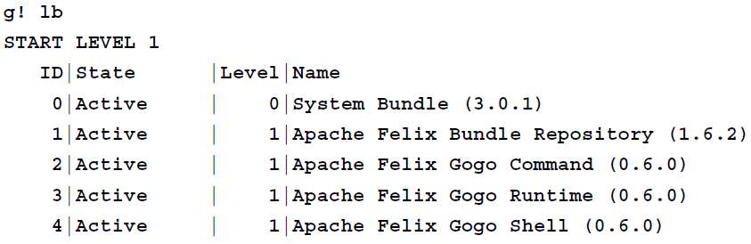
Felix Gogo (cont.)
The lb command is used to list bundles.
The listing provides following useful information:
Each bundle has unique id on install.
Bundle’s lifecycle state.
Bundle start level
Bundle name and version
The help command will list all the commands that are supported.

Slide 12
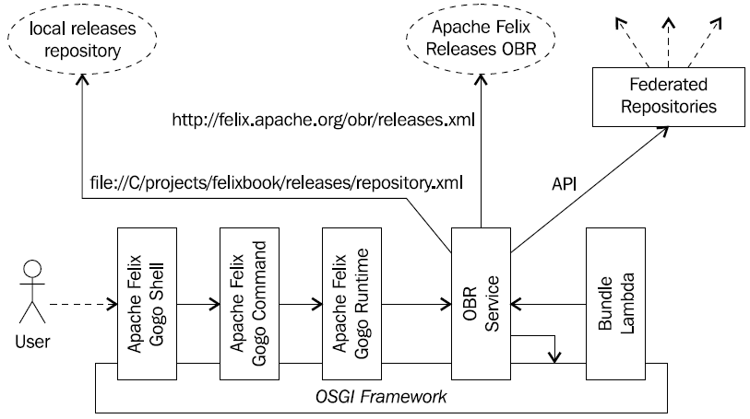
OSGi Bundle Repository
The OSGi Bundle Repository (OBR) describest how to get access to a set of remote bundle repositories.
Each remote repository provides a list of bundles available for download.
The bundles declared in an OBR repository can then be downloaded and installed to an OSGi framework like Felix.

Slide 13
OSGi Bundle Repository (cont.)
The Gogo Command bundle registers a set of commands for the interaction with the OBR service.
Those commands allow registering repositories, listing their bundles, and requesting their download and installation.
Sample commands:
obr:repos: manage the repositories
obr:list: finds bundles in the registered repositories
obr:info: retrieves and displays the information
obr:deploy: download bundles from the repository and install into Felix.

Slide 14
Conclusions
Apache Felix is easy to use.
Apache Felix is documented.

Slide 15

Bibliography
http://felix.apache.org/
http://en.wikipedia.org/wiki/Apache_Felix
http://en.wikipedia.org/wiki/OSGi
Packtpub – OSGi and Apache Felix 3.0 Beginners Guide

